Slide 1
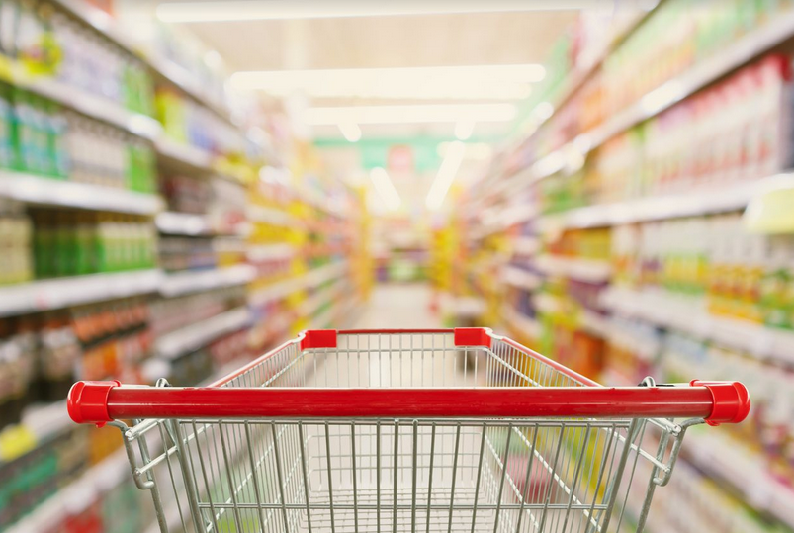
Packaged Food:
What is it?
Team 16
Jonathan Chen, Samuel Shen, Jonathan Chen
Mentor: Vikrant Aute
https://www.culinarynutrition.com/how-to-choose-healthy-packaged-foods/

Slide 2
Background
Dataset Information
USDA open-sourced dataset on food ingredients and food category
Part of larger branded food product database
Goals
Understand what ingredients go into packaged food and their nutritional impact
Visualize findings for easier comprehension
Answer our 4 questions

Slide 3


Methodology
Data Cleaning
OpenRefine
Python
Data Analysis
Python
Data Visualization
Bar charts created through Python Matplotlib library
https://en.wikipedia.org/wiki/OpenRefine
https://en.wikipedia.org/wiki/Python_(programming_language)
Notes:
Data cleaning - special characters, uniform formatting (lowercase), eliminate empty values
Analysis was text analysis - no regression models.

Slide 4
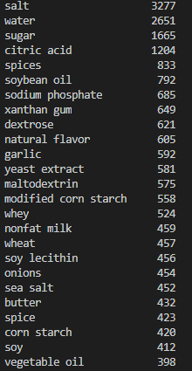
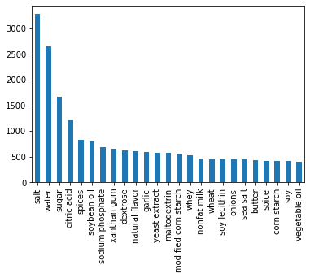
What are the most popular ingredients in all meals overall?
Most items are preservatives, additives or stabilizers
Lots of soy products
Some redundancy
Notes:
Mention ~4.4k rows for context, mention sea salt/salt redundancy

Slide 5
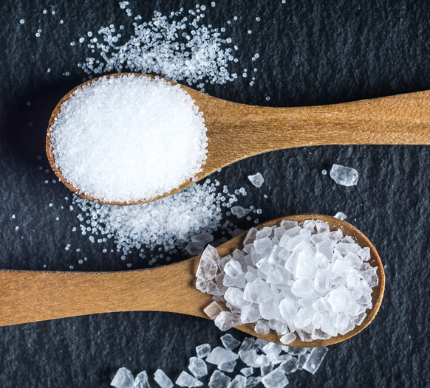
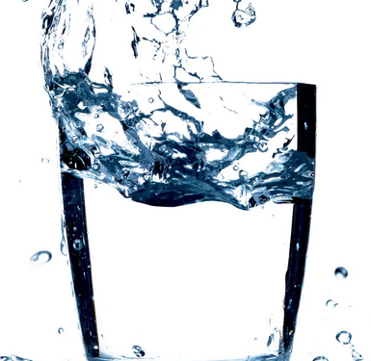
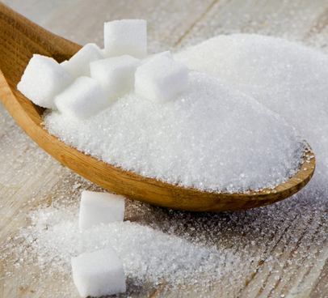
What are the most popular ingredients in each meal category?
Salt, water, and sugar dominate vast majority of categories
Preservatives and spices are also very common in many categories
Most ingredients seem to be physically miniscule items
https://media.self.com/photos/5cc0781558c4c36a45d91deb/1:1/w_3569,h_3569,c_limit/cooking-salts.jpg
https://i.guim.co.uk/img/media/eda873838f940582d1210dcf51900efad3fa8c9b/0_469_7360_4417/master/7360.jpg?width=1200&height=1200&quality=85&auto=format&fit=crop&s=4136d0378a9d158831c65d13dcc16389
https://www.foodbusinessnews.net/ext/resources/2020/4/WoodenSpoonSugar_Lead.jpg?t=1586457447&width=1080

Slide 6
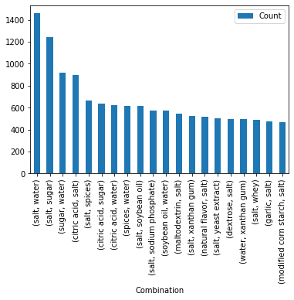
What combinations have appeared together most often?
Salt is the most common ingredient within combinations of ingredients.
Salt is used not only as a preservative which is important for packaged foods but also for flavor!

Slide 7
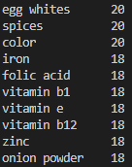
Which are the healthiest meal options?
Dairy/egg-based products/ meals seem to be the healthiest category because of the high amount of vitamins/minerals and low amount of preservatives in their top ingredients

Slide 8
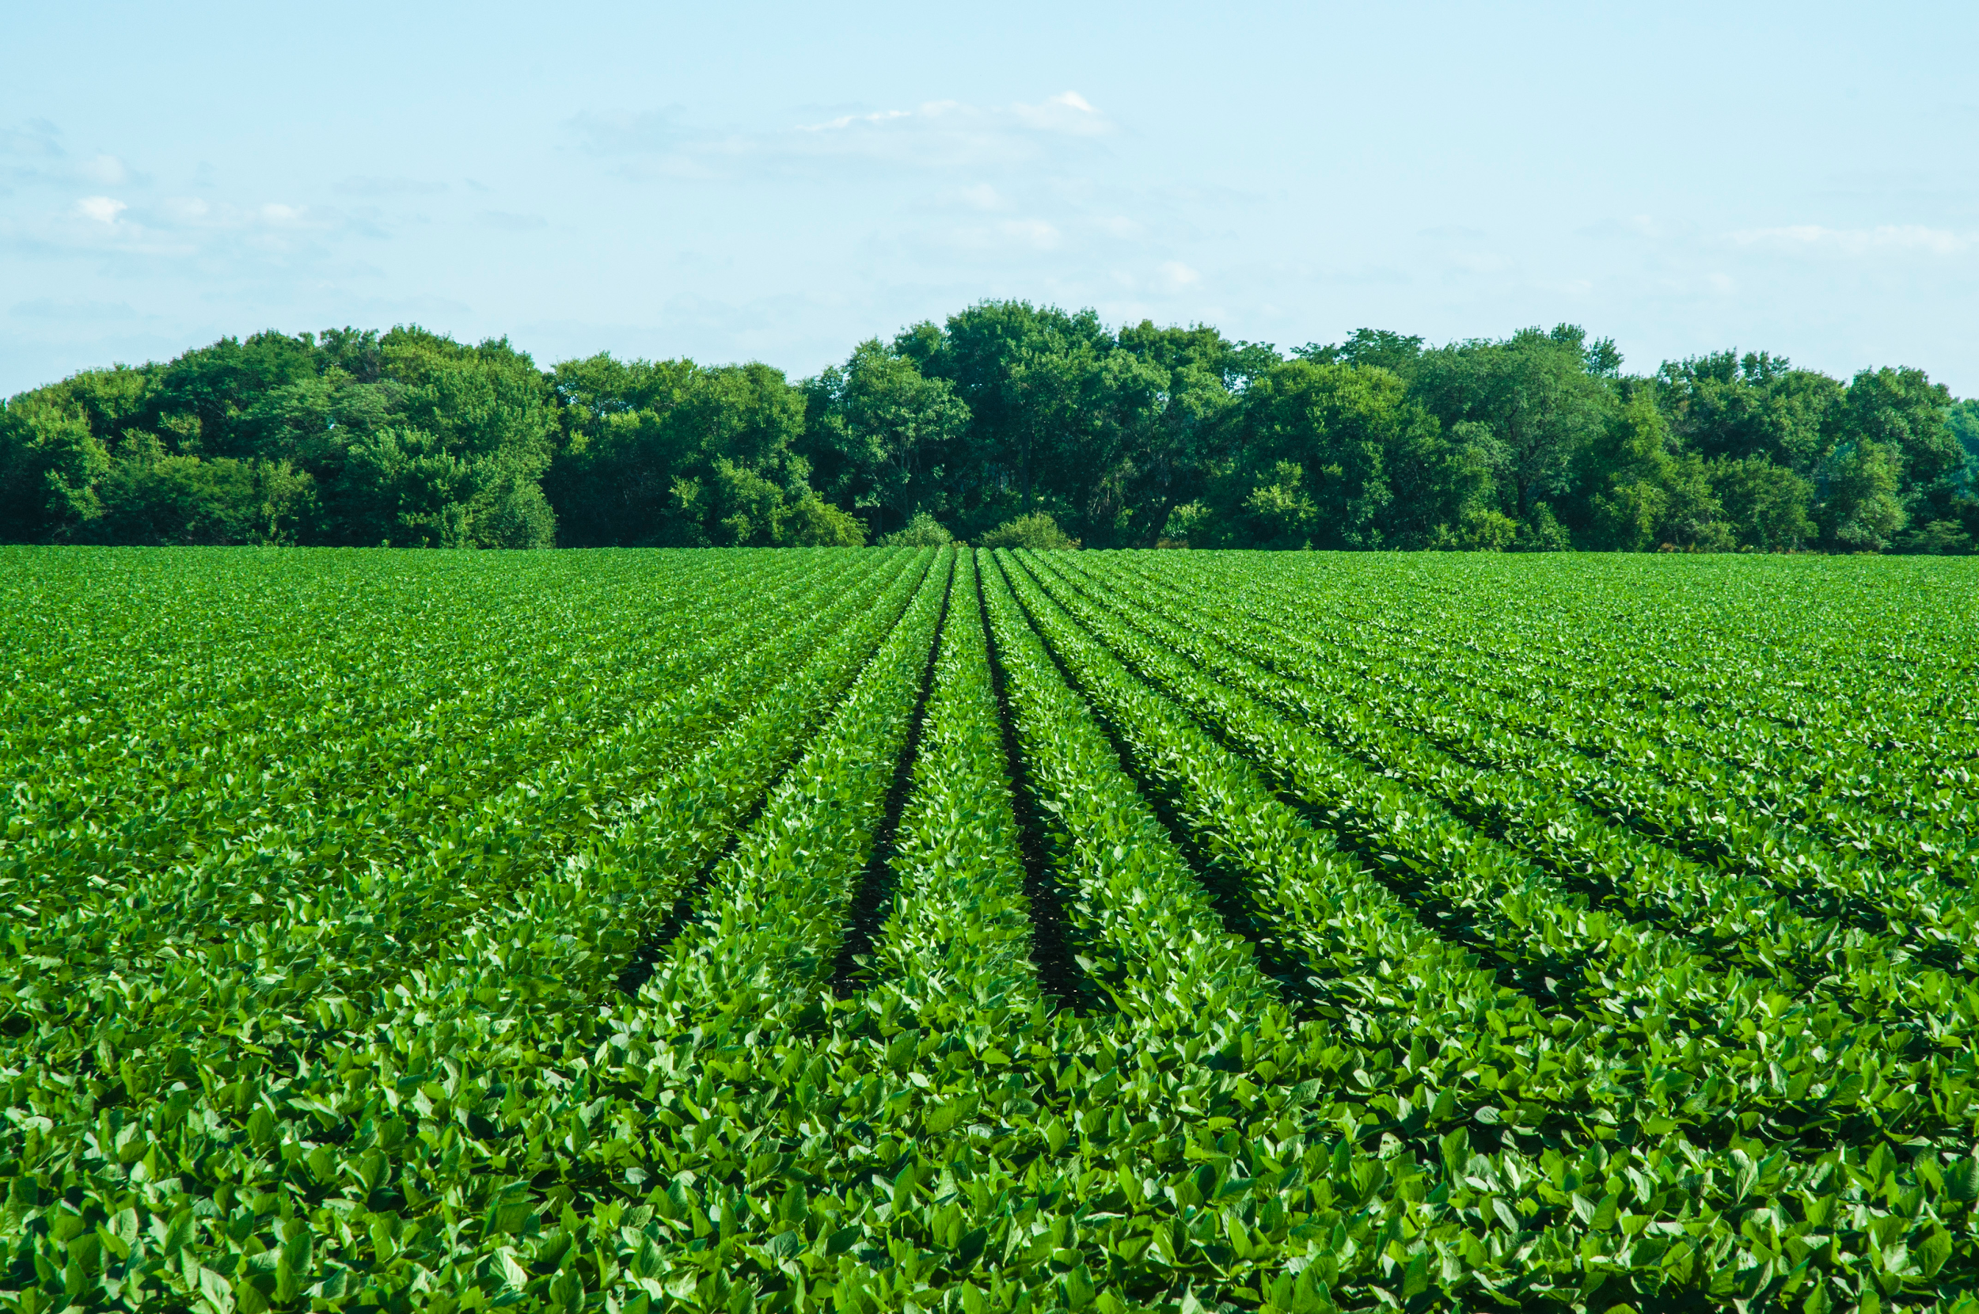
What supply chain aspects should we focus on?
Since soy was a top overall agricultural ingredient, companies should invest and focus on growing, harvesting, processing, and manufacturing soy
Not only is soy an important food ingredient, but it is also used in the meat industry
https://static.agriculture.com/styles/node_article_image_full_large/s3/s3fs-public/image/2016/09/26/StraightSoybeans-WideShot.jpg?timestamp=1550619443

Slide 9
Takeaways and Recommendations
Most packaged foods are not as healthy as we may think
Most of the ingredients are not what the average person would expect
Most people are unfamiliar as to what many of the top ingredients even are
We would recommend dairy/egg based products for highest nutritional value
We would recommend a focus on the soy industry

Slide 10
Credits
Thanks to: UMD Discord data science team, dataset partners, data analysts, volunteers, judges, UMD Ischool, Stack Overflow, each other!
Special thanks to Vikrant, our mentor.

